Slide 1
Open sis

Slide 2
Introduction
Open source is one of the several free and open source students information system available for higher education institutions
It is a web based application developed and maintaned by open solutions for education

Slide 3
Mission
To create the best open source student information system(sis) that will be equal to or better than the best commercially available sis software in the market

Slide 4
Goal
Keep it open source,always
Bring out 3 to 4 version upgrades each year
Get customers involved ans co-create
Build a vibrant community that will spread the love

Slide 5
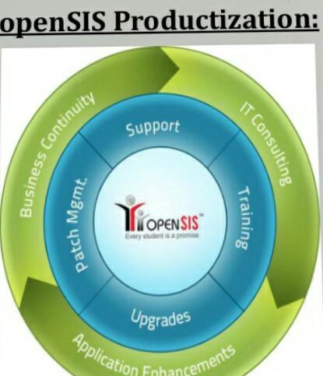
Services
Professional services
It consulting

Slide 6
Product features
Student photographs
Parents’s and guardian’s information
Report cards
Staff certification
Online applicant

Slide 7
Open sis
Developer(s) | OS4Ed
Written in | PHP
Type | Students information

Slide 8
License
GNUGPLv27

Slide 9
Thank you

